Slide 1
Home page
Logo
FAQs
Information about the service and examples
Login or register
Footer

Slide 2
FAQs
Logo
FAQs list
Footer

Slide 3
Gallery
Logo
User name
Presets Chart gallery
Chart example
+
Add new Chart
Chart example
+
Add new Chart
Chart example
+
Add new Chart
Dashboard
Footer

Slide 4
Detailed view of chart and metrics
Logo
User name
Chart
Dashboard
KPI 1
KPI 2
KPI 3
KPI 4
General info of process data
Footer

Slide 5
Profile
Logo
User name
Profile general view
Profiles settings and info
Dashboard
Footer

Slide 6
Definición de la navegación entre las vistas
Public
Home page
Register
FAQs
Private
Gallery
Detailed view of chart and metrics
Dashboard
Profile

Slide 7
Dependencias Front-end
React Router DOM
Axios
D3.js
Bootstrap

Slide 8
Dependencias en el BackEnd
CORS
Express
Pg
Xlsx
Jest
Dotenv
JsonWebToken
Bcryptjs
Pdfkit-table

Slide 9
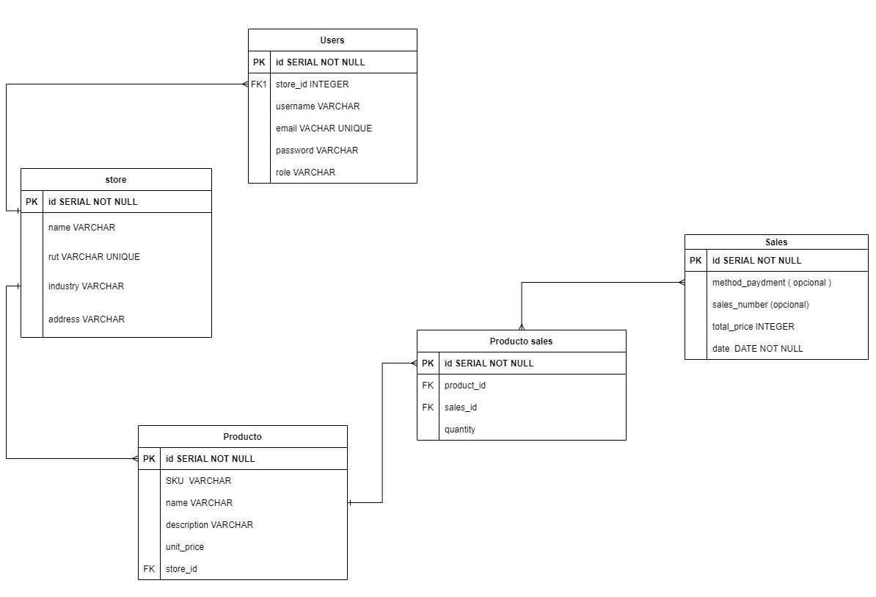
Diseño las tablas de la base de datos y sus relaciones

